Slide 1
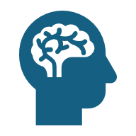
Zoom Behavior Insight
Presented by:
Ofir Duek , Aviv Meir , Rotem Aloni

Slide 2
Project Overview
We build a model that maps student images from Zoom classes to a predefined discrete behavior vector describing observable learning-related attributes such as gaze direction, environment type, presence of headphones, and objects held in hand .

Slide 3
Problem & Use Case
The Problem :
In large Zoom based classes, instructors lack visibility into individual student behavior during the lesson.
Impact:
It is difficult to assess student engagement and identify potential
distractions based solely on the Zoom interface.
Our Approach:
Automatically extract a structured behavior representation for each student from a single Zoom frame.
Example:
For each student, the system outputs a discrete behavior vector:
Gaze : Camera
Environment : Indoor
Privacy : Private
Headphones : WithoutHeadphones
ObjectInHand : Phone

Slide 4
ML Task & Output Definition
Task : Multi-task image classification for extracting discrete behavioral attributes from student images in Zoom frames.
Input – Single 400x400 RGB webcam image of one student in a Zoom class
Output : A predefined discrete behavior vector with the following components: Camera gaze
Environment, Privacy, Headphones, Object In Hand.

Slide 5
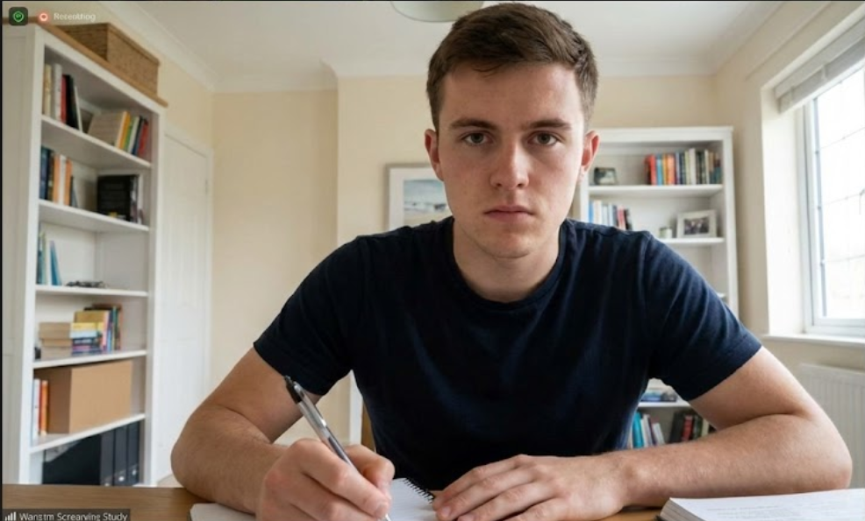
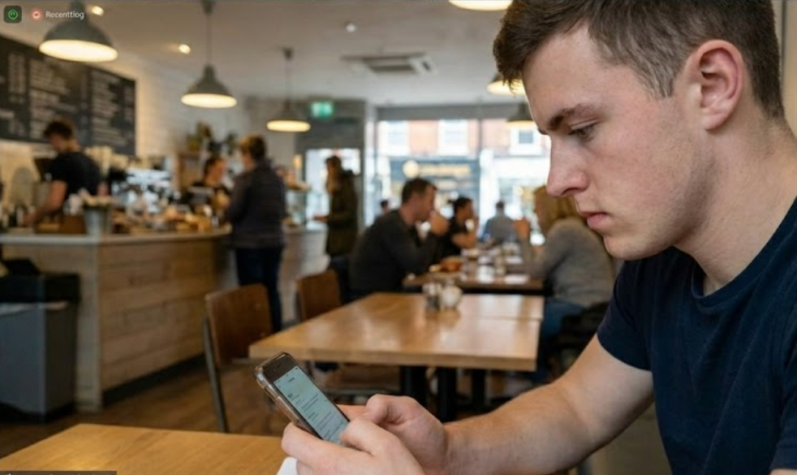
Example 1: Student looking at the
screen/camera, in a quiet room, writing notes.
Example output:
Gaze: Camera
Environment: Indoor
Privacy: Private
Headphones: Without Headphones
Object In Hand: Pen
Example 2: Student looking down at a phone,
slightly turned away from the screen.
Example output:
Gaze: Not Camera
Environment : Outdoor
Privacy : Public
Headphones : Without Headphones
Object In Hand : Phone

Slide 6
Dataset Overview
Data Sources:
Real webcam-like images of students sitting in front of a laptop.
Synthetic images generated with Stable Diffusion + inpainting using prompts designed to control the predefined behavior attributes, including gaze direction, environment type, background privacy, presence of headphones, and objects held in hand.
Annotations (Labels):
Each image is annotated with a predefined discrete behavior vector, according to the labeling guidelines.
The behavior vector includes the following attributes:
  • Gaze (Camera / Not camera / Eyes closed)
  • Environment (Indoor / Outdoor)
  • Privacy (Private / Public)
  • Headphones (With headphones / Without headphones / Unknown)
  • Object in hand (Phone / Pen / Cup / Other / None / Unknown)
Annotations are stored per image in a structured CSV file, Labels are stored in a CSV file together
with the image filename.
Data Split
Train 80%, validation 10%, test 10%.
Test set will use only real images to measure performance on real data.
Size & Format
Target: ~1000-2000 images in total.
RGB, 400x400 JPG/PNG files.

Slide 7
Data Synthetic Generation Pipeline
Choose a target behavior configuration
(e.g., Gaze = Camera, Environment = Indoor, Privacy = Private, Headphones = Without headphones, Object in hand = None)
Generate a base “student at laptop” image using Stable Diffusion.
Use inpainting to edit specific regions and control: Gaze direction (towards the camera / away / eyes closed) , Environment type (indoor / outdoor) , Background privacy (private / public) , Headphones (add / remove) , Object in hand (add / remove phone, pen, cup, or other objects)
Save the final synthetic image together with its corresponding discrete behavior vector annotation.

Slide 8
Behavior Control & Prompt Examples
What we control in the synthetic images:
• Gaze direction – Camera / Not camera / Eyes closed
• Environment type – Indoor / Outdoor
• Background privacy – Private / Public
• Headphones – With headphones / Without headphones
• Object in hand – Phone / Pen / Cup / Other / None
Examples:
Prompt example - Student sitting at a desk, looking at the laptop screen, indoor study room, no other people in the background, no headphones, empty hands.
Prompt example – Student sitting in a busy café, looking down at a smartphone, wearing headphones, people visible in the background.

Slide 9
Model & Training Setup
We use a pretrained CNN and adapt it to predict a predefined discrete behavior vector for each student image.
    Model:
      Pretrained CNN backbone (e.g., ResNet-18)
      Replace the final layer with multiple output heads, one per behavior attribute : Gaze, Environment, Privacy, Headphones, Object In Hand.
      Each head predicts a discrete class (softmax) for its attribute.
    Training setup:
      Input preprocessing
        Resize each image to 400x400 RGB.
        Normalize pixel values.
        Simple data augmentation (random horizontal flip, small brightness/contrast changes).
      Loss & optimizer
        Loss: Cross-entropy loss applied separately to each behavior attribute.
        Optimizer - Adam with a small learning rate.
      Training modes
        Baseline: Freeze the CNN backbone and train only the output heads.
        Fine-tuned model: Unfreeze the last CNN layers and train them jointly with the output heads.

Slide 10
Experiments & Metrics
We define the evaluation metrics and the experimental setup used to assess the model.
Planned experiments
Baseline vs. fine-tuned CNN:
Same train/validation data (real + synthetic)
  Model 1 : backbone frozen, train only the output heads.
  Model 2 : fine-tune the last CNN layers together with the output heads.
Real-only vs. real + synthetic data: Same fine-tuned architecture
  Train on real images only.
  Train on real + synthetic images.
  Evaluate both models on the same real-image test set.
Metrics :
We evaluate the model using
• Accuracy per behavior attribute (Gaze, Environment, Privacy, Headphones, Object In Hand)
• Macro F1-score computed separately for each attribute
Evaluation procedure
Compare predicted and ground-truth behavior classes
Compute accuracy and F1 per behavior
Report results on the real-image test set.

Slide 11
Novelty & Contribution
Behavior-based representation of Zoom webcam images: Each student image is mapped to a predefined discrete behavior vector, rather than a single label.
Synthetic Zoom-like dataset with controllable behaviors: We use Stable Diffusion and inpainting to generate and edit student images , while explicitly controlling the predefined behavior attributes.
Systematic evaluation of model and data setups:
We compare baseline vs fine-tuned CNNs and real-only vs real + synthetic training to evaluate performance on real Zoom webcam images.

Slide 12
Risks, Limitations & Next Steps
Risks & limitations:
  • Ambiguous images where behavior attributes are hard to label
  (e.g., unclear gaze, partially visible objects)
  • Synthetic images may not perfectly match real Zoom webcam frames
  • Limited size and diversity of the real-image dataset
Next steps:
  Finalize data collection and labeling guidelines for the predefined behavior attributes.
  Train the baseline and fine-tuned CNN models.
  Run the experiments and analyze classification performance per behavior attribute on the real-image test set.

